Slide 1
How to order and receive and invoice a physical item from copy cataloging
Yoel Kortick
Senior Librarian

Slide 2

Introduction
Copy cataloging the bibliographic record
Creating the POL
Inventory was created when the POL was created
Receiving the inventory
Invoicing (paying for) the POL
Agenda

Slide 3
Introduction

Slide 4
Introduction
In this example we will create a bibliographic record from copy cataloging, and then create an acquisitions order (POL – Purchase Order Line) for a physical item of the bibliographic record.
We will also invoice (pay for) the order.
We will do this for title "Women's movements in twentieth-century Taiwan", ISBN 9780252033957.
We will copy catalog from "The National and Copenhagen University Library"
Note: In this presentation any time we state "POL" we mean "Purchase Order Line" which is an acquisitions order.

Slide 5
Introduction
The workflow used here for ordering, receiving and invoicing is the same regardless of how the bibliographic record is created.
As stated, we are creating the bibliographic record via copy cataloging. However, if we had for example catalogued an original bibliographic record from scratch, we would still use the same workflow for ordering, receiving and invoicing.

Slide 6
Introduction
In our example we will receive the item and then later pay the invoice.
It is possible also to first pay the invoice and then later receive the item.
It is also possible to pay and receive as pat of the same process.
This depends on workflows of the institution as well as of the vendor.

Slide 7
Copy cataloging the bibliographic record

Slide 8
Copy cataloging the bibliographic record
We can access the copy cataloging options by either of the following two options:
  Menu "Resources > Cataloging > Search Resources"
  From within the Metadata Editor choose menu "Search & Browse > Search Resources"
Both options bring the user to the same place.

Slide 9
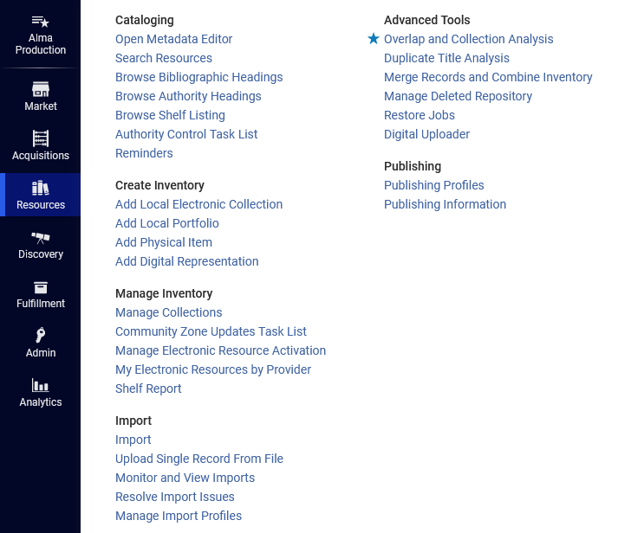
Copy cataloging the bibliographic record
Menu "Resources > Cataloging > Search Resources"

Slide 10
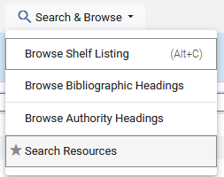
Copy cataloging the bibliographic record
From within the Metadata Editor choose menu "Search & Browse > Search Resources"

Slide 11
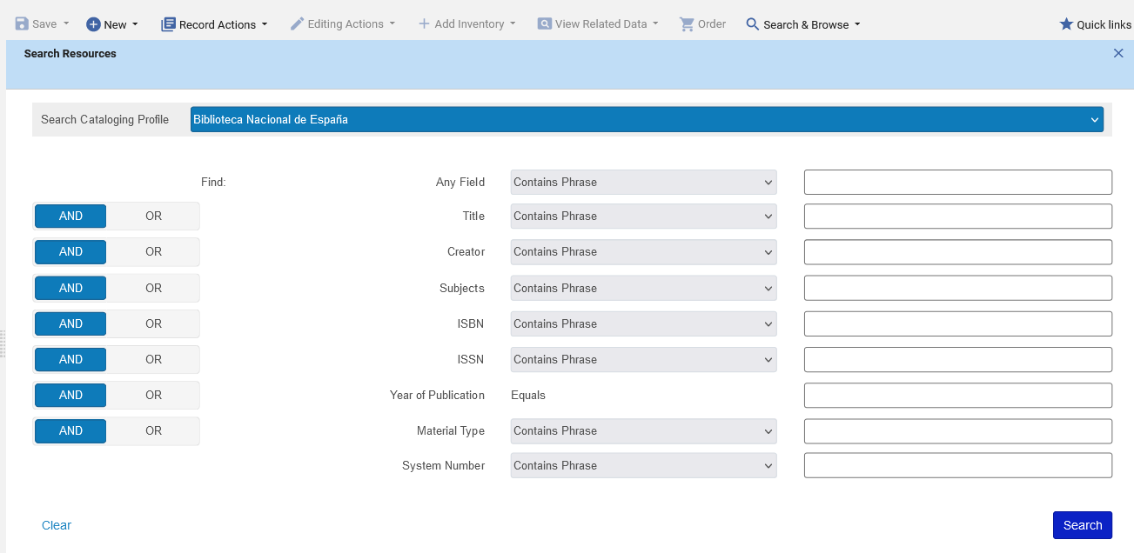
Copy cataloging the bibliographic record
We arrive here
Click here to view and choose the desired Search Cataloging Profile. It defaults to the last used Search Cataloging Profile.

Slide 12
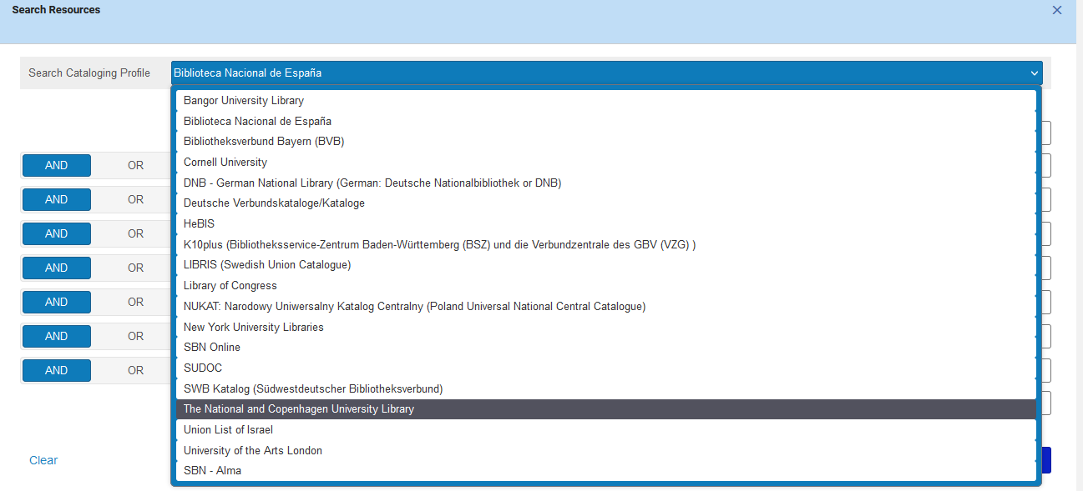
Copy cataloging the bibliographic record
We will now choose "The National and Copenhagen University Library"

Slide 13
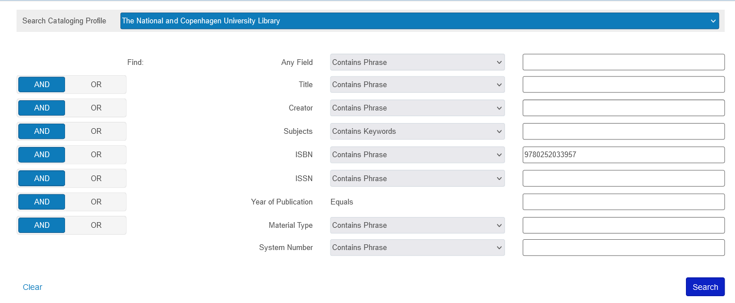
Copy cataloging the bibliographic record
We will search by ISBN

Slide 14
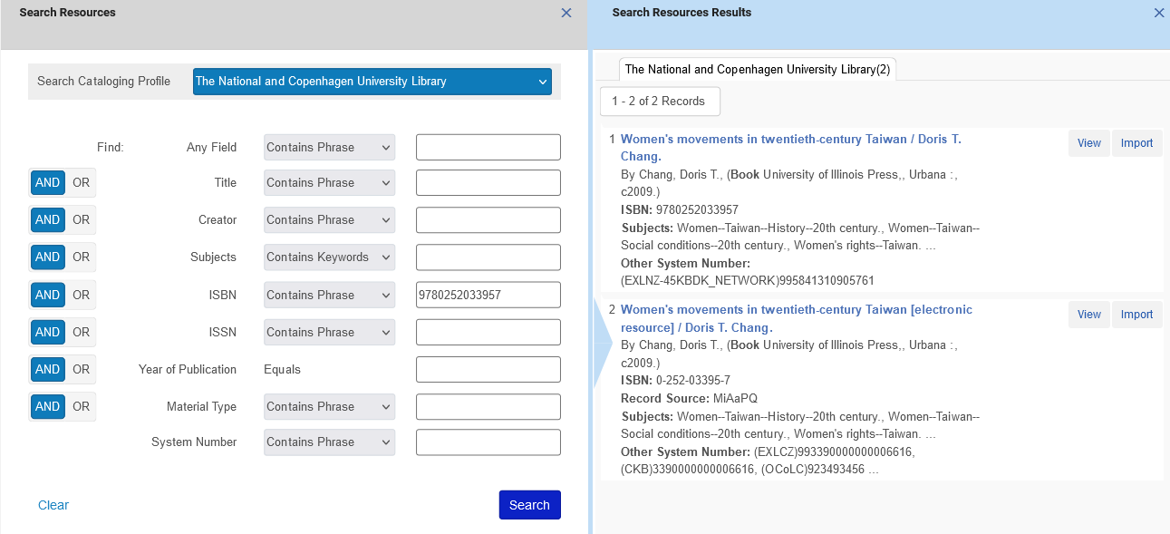
Copy cataloging the bibliographic record
We have two results
We can click "Import" to directly import the record.
We can click "View" to view the full record.
From the "View" screen we can also import

Slide 15
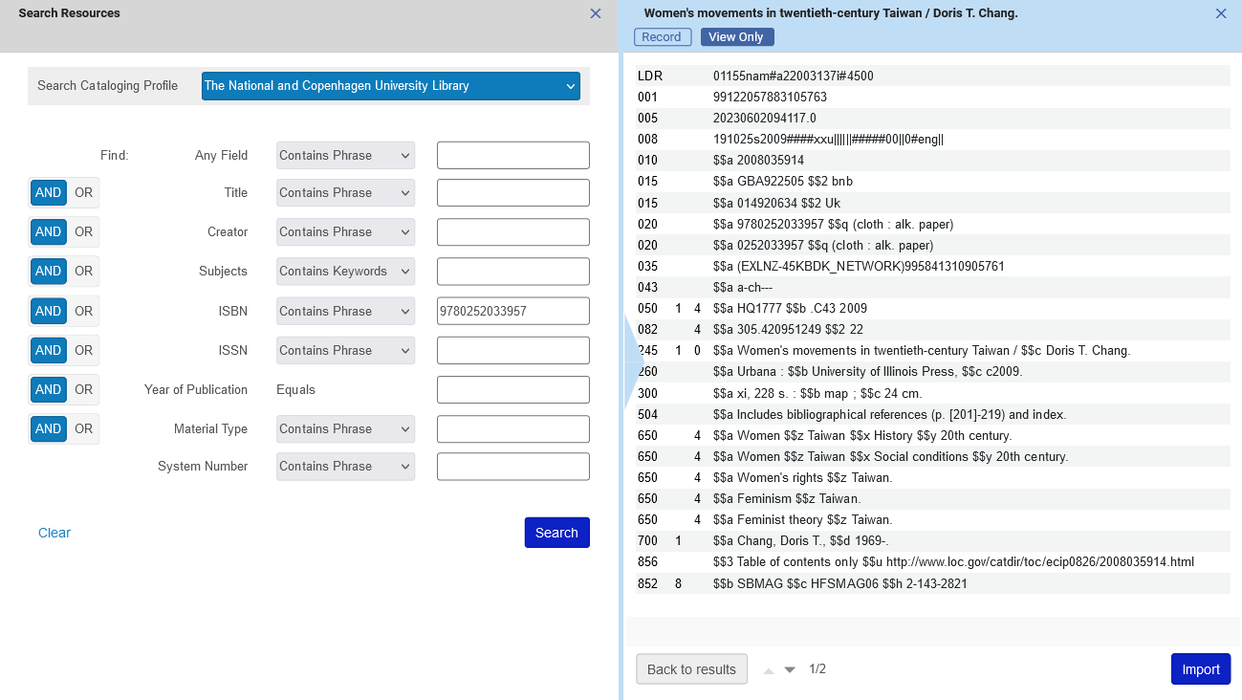
Copy cataloging the bibliographic record
We clicked "View" on the first record and decide to import this record

Slide 16
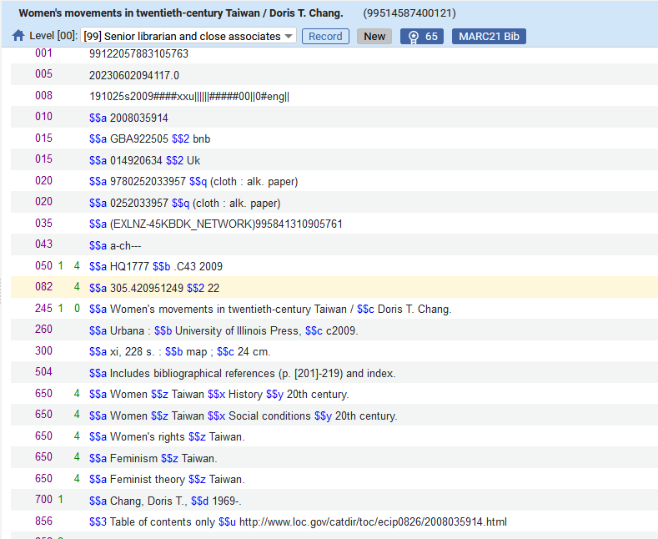
Copy cataloging the bibliographic record
The record opens in the Metadata Editor.
We could directly place an order for this record "as is".
But we will first edit as desired.
For example, we will change the 650 fields to have a second indictor 0 and perhaps also edit the contents.

Slide 17
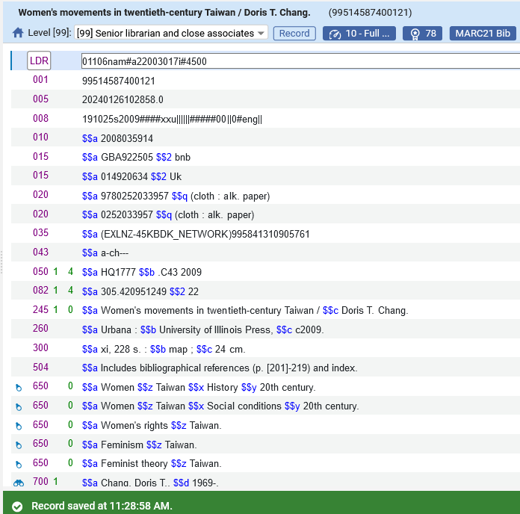
Copy cataloging the bibliographic record
We have edited and saved the record as desired.
650 fields now have a second indictor 0 and are linked to LCSH headings.
Record is saved.

Slide 18
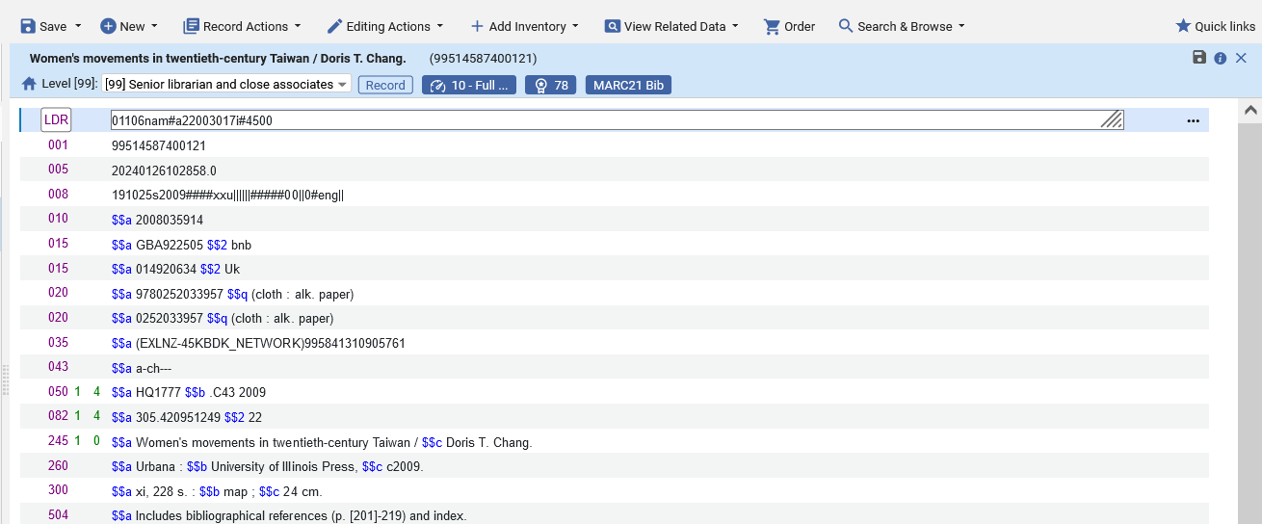
Copy cataloging the bibliographic record
Now we will create the POL. This can be done by clicking the "Order" icon on top or by using shortcut key ctrl+alt+O

Slide 19
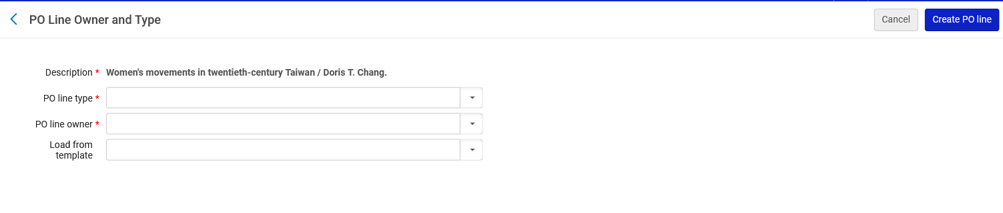
Copy cataloging the bibliographic record
We arrive to the "PO Line Owner and Type" screen to create the POL.

Slide 20
Creating the POL

Slide 21
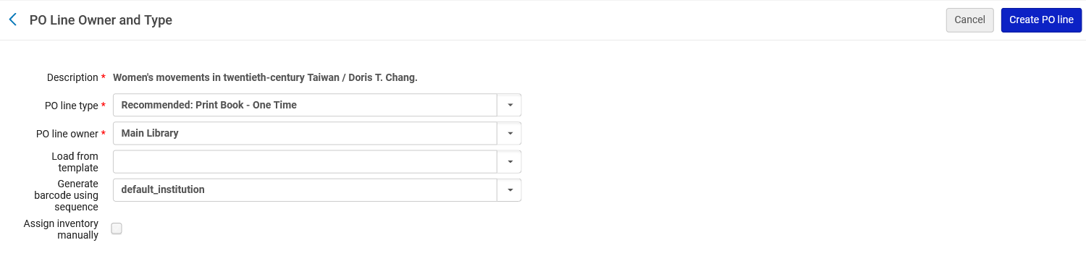
Creating the POL
We fill in the "PO Line Owner and Type" screen as desired.
After doing so we click "Create PO Line"
We have chosen:
PO Line Type: Print Book – One Time
PO line owner: Main Library
We are not checking "Assign inventory manually". We would check this only if we want to prevent Alma from automatically creating an inventory item for the new PO line.

Slide 22
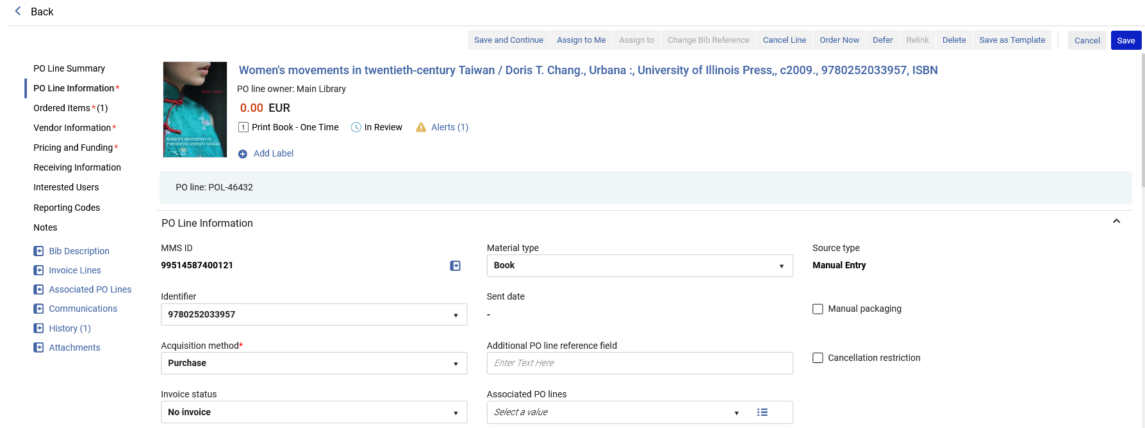
Creating the POL
The POL is created
We will leave the acquisition method as "purchase".

Slide 23
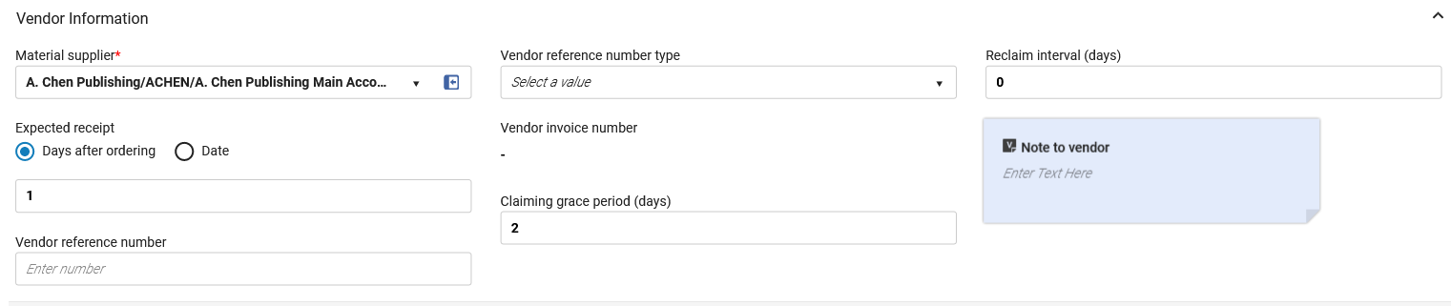
Creating the POL
In the POL we will fill in the Vendor Information

Slide 24
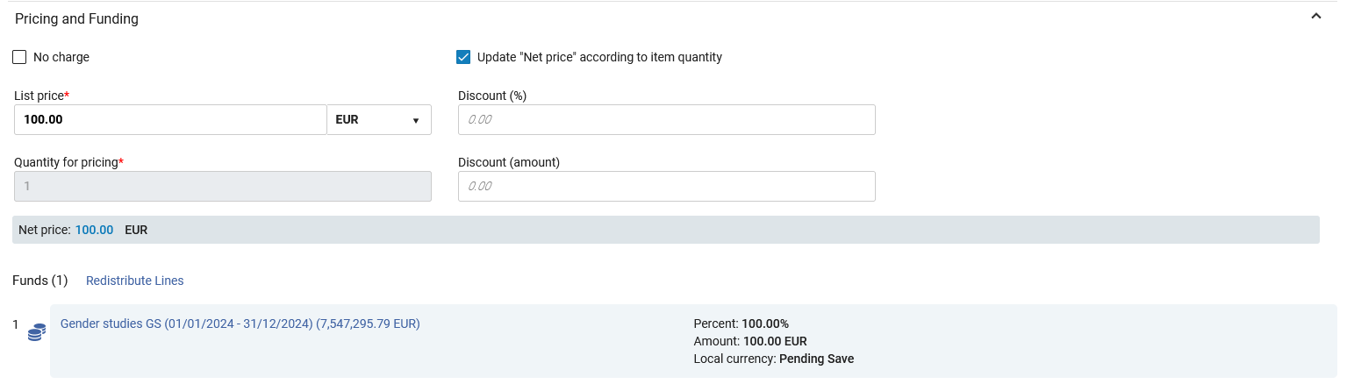
Creating the POL
In the POL we will fill in the Pricing and Funding Information

Slide 25
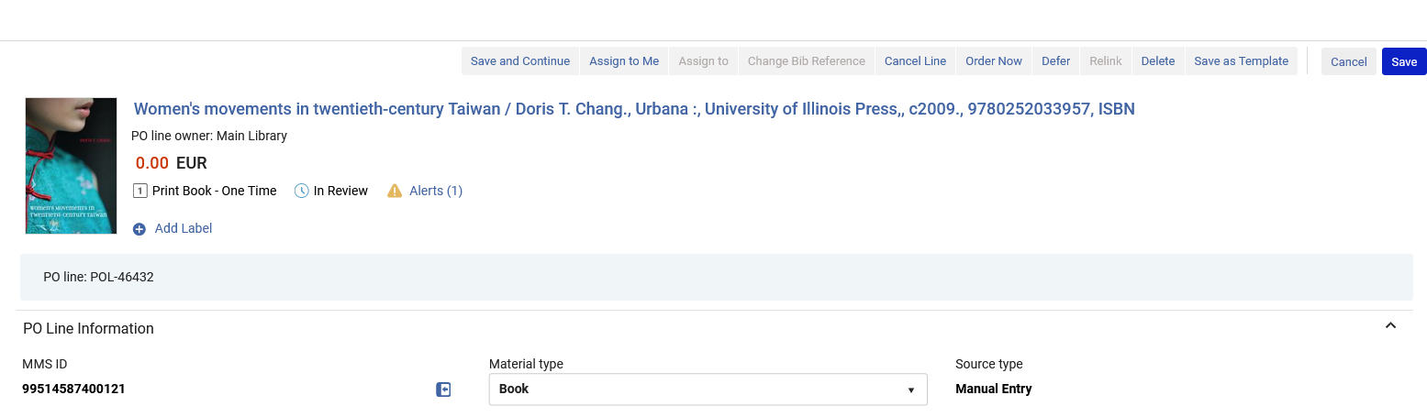
Creating the POL
We will send the order by clicking "Order Now".

Slide 26
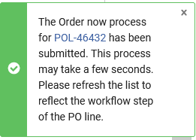
Creating the POL
The ordering process has begun

Slide 27
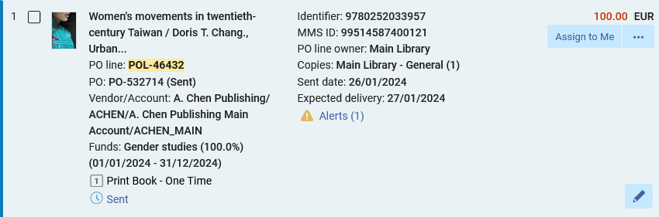
Creating the POL
The POL has been packaged into PO (Purchase Order) PO-532714 and sent to the vendor.

Slide 28
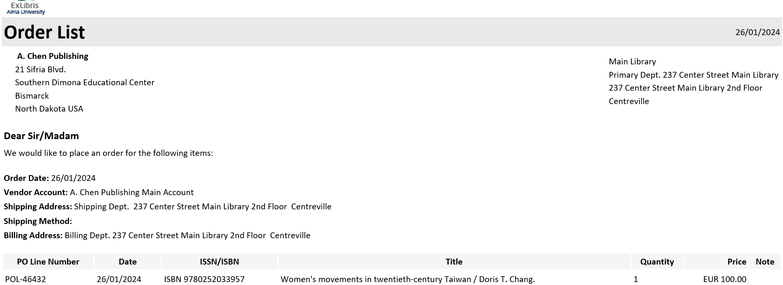
Creating the POL
The vendor has received the POL via email (because the acquisition method was "Purchase").

Slide 29
Inventory was created when the POL was created

Slide 30
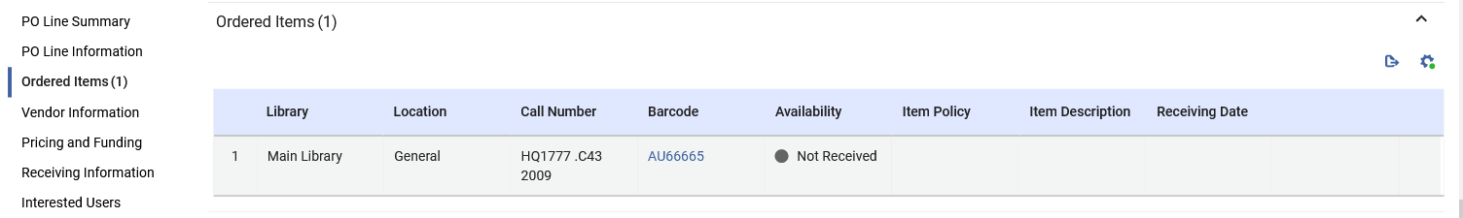
Inventory was created when the POL was created
As part of the process, when the POL was created a physical item was created.
As previously stated, the item was automatically created because when creating the POL we did not check "Assign inventory manually"
Here is the physical item as seen inside the POL.

Slide 31
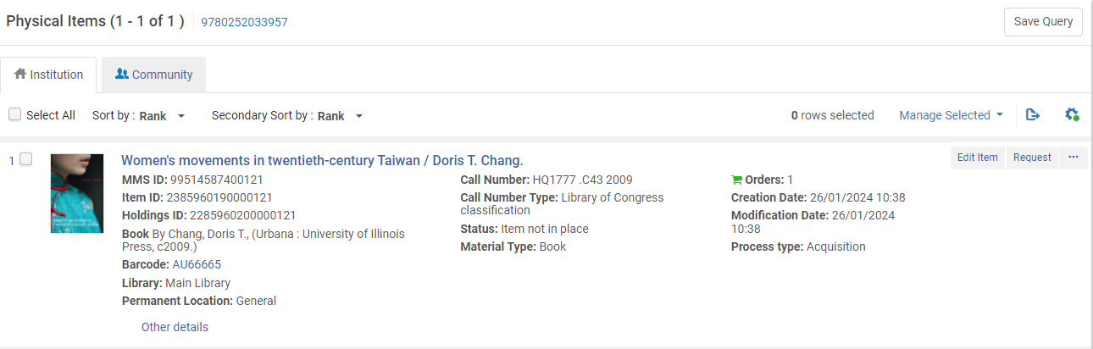
Inventory was created when the POL was created
The item appears in repository as search as Status "Item not in Place" and in Process type "Acquisition"

Slide 32
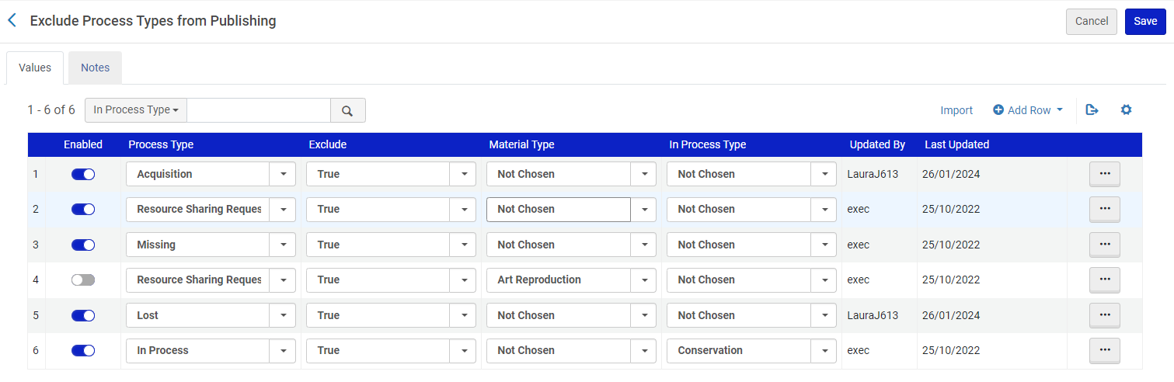
Inventory was created when the POL was created
Note that at "Configuration > Discovery > Other > Exclude Process Types from Discovery Indexing" it is possible to define that inventory with Process Type "Acquisition" will not be published to discovery.

Slide 33
Receiving the inventory

Slide 34
Receiving the inventory
To receive inventory the staff user must be at either an acquisitions department or at a circulation desk that supports acquisitions.

Slide 35
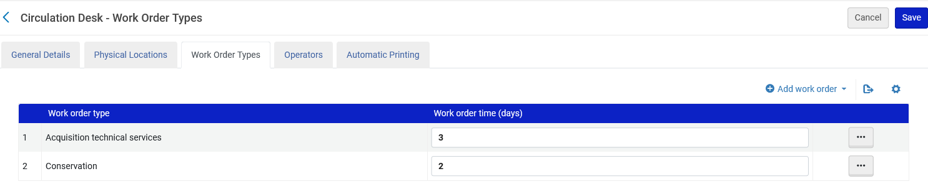
Receiving the inventory
The "Main Library – Main Circulations Desk" supports acquisitions.

Slide 36
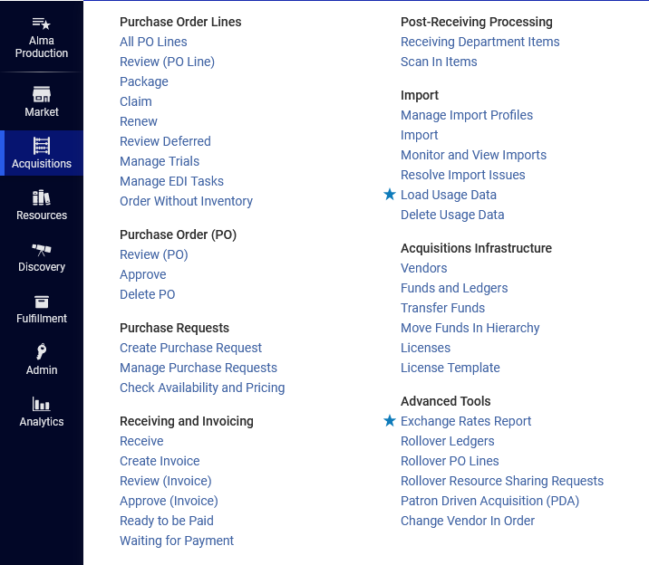
Receiving the inventory
We can arrive to the receiving workbench via "Acquisitions > Receiving and Invoicing > Receive"

Slide 37
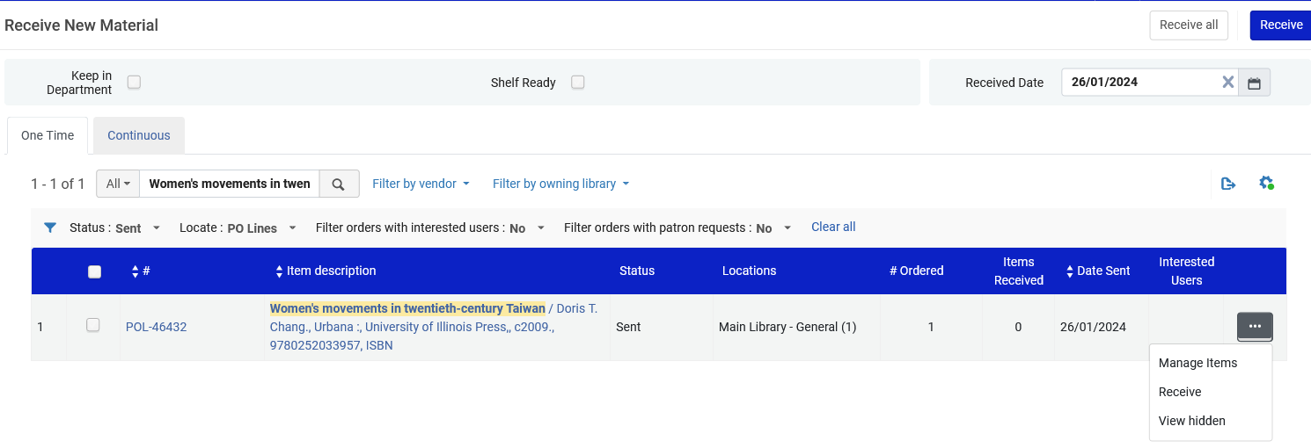
Receiving the inventory
We will receive the item.
Note that we are not checking "Keep in Department" and therefore after receiving the item it will be in its permanent location (or in transit to the permanent location).
A work order will not be created for the item.

Slide 38
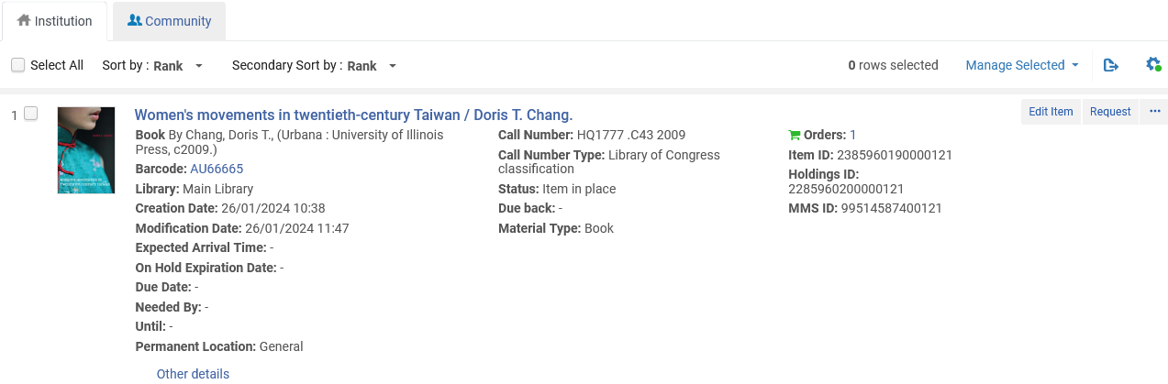
Receiving the inventory
The item is no longer in Status "Item not in Place" and no longer in Process type "Acquisitions". It is Status "Item in Place" .

Slide 39
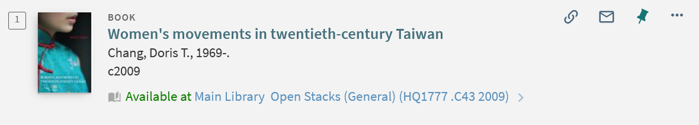
Receiving the inventory
The record appears in discovery.

Slide 40
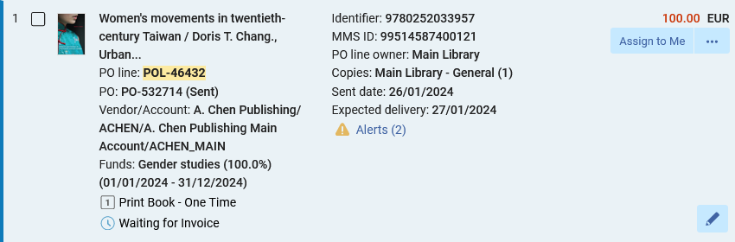
Receiving the inventory
The POL is now "Waiting for invoice"

Slide 41
Invoicing (paying for) the POL

Slide 42
Invoicing (paying for) the POL
We now have the POL for which the resource has been received but nothing has been paid.
In Alma we will now manually create an invoice from the PO (Purchase Order).
  The advantage of creating a invoice from the PO is that the invoice is created with an invoice line associated with the POL

Slide 43
Invoicing (paying for) the POL
Note, as mentioned in the introduction, that in our case we first received the item and then we are paying for it.
The order could be reversed whereby first the institution pays for the resource and then activates it.
Also, the receiving and paying can be done at the same time.
This depends on flows of the vendor and the Alma institution.

Slide 44
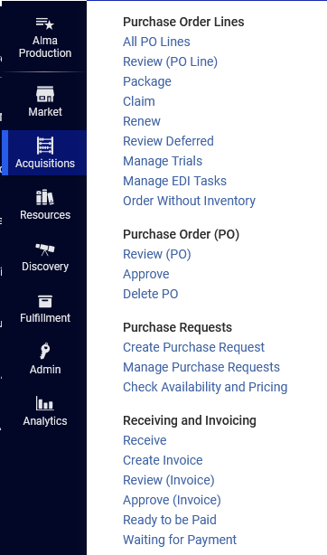
Invoicing (paying for) the POL
Acquisitions > Receiving and Invoicing > Create Invoice

Slide 45
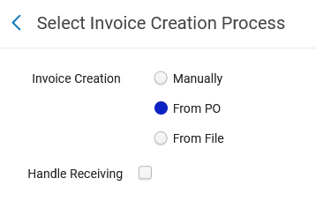
Invoicing (paying for) the POL
We will choose "From PO"

Slide 46

Invoicing (paying for) the POL
We will select the PO

Slide 47
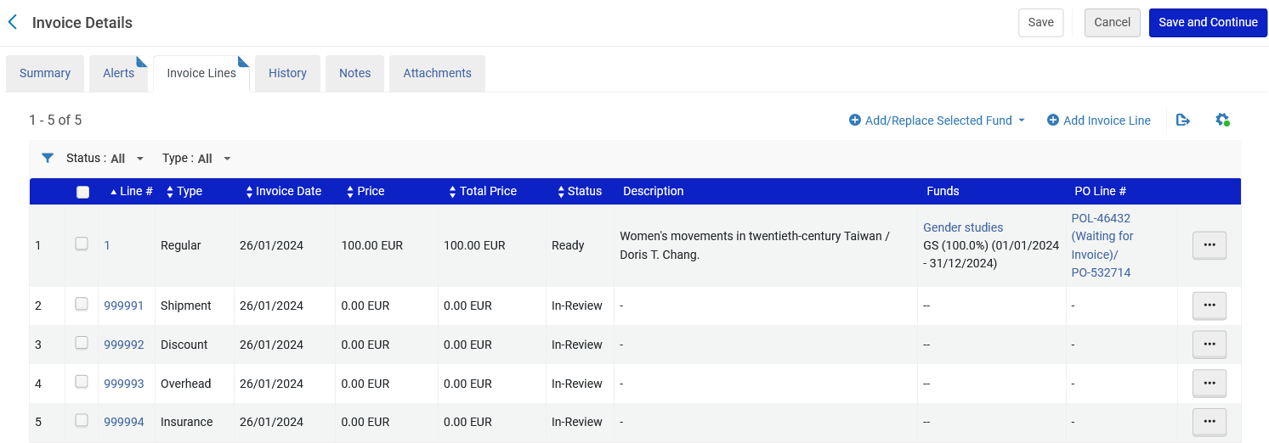
Invoicing (paying for) the POL
An invoice is created with an invoice line associated with the POL

Slide 48
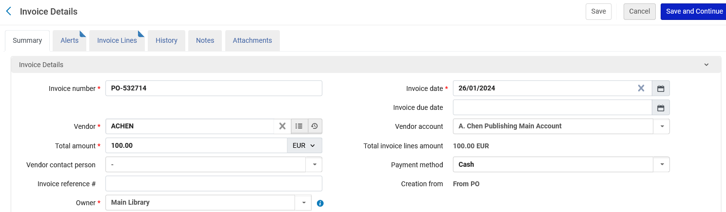
Invoicing (paying for) the POL
We will switch to the "Summary" tab and pay the invoice
We are choosing here Payment Method "Cash" though often this will be done with a different method which will synchronize via an integration profile with the finance department.

Slide 49
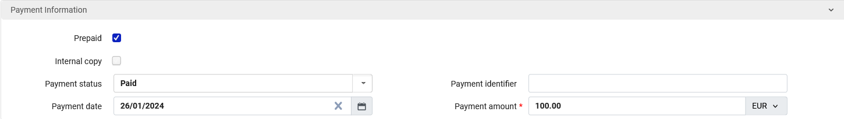
Invoicing (paying for) the POL
While still in the "Summary" tab we will complete the details and click "Save and Continue".

Slide 50
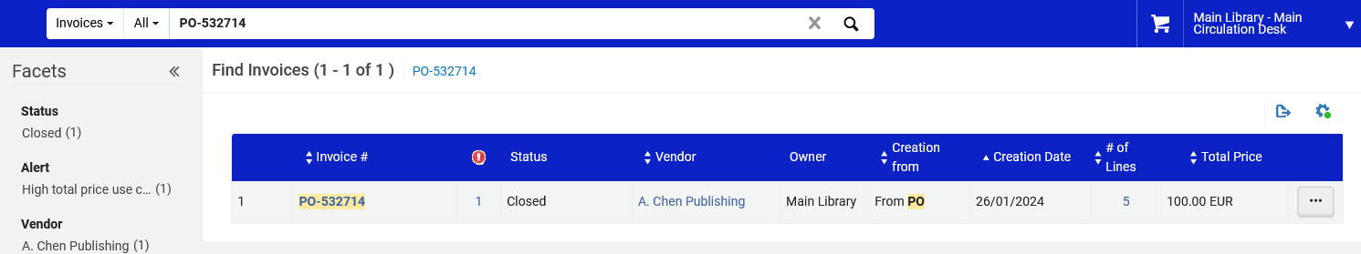
Invoicing (paying for) the POL
Now the Invoice is closed.

Slide 51
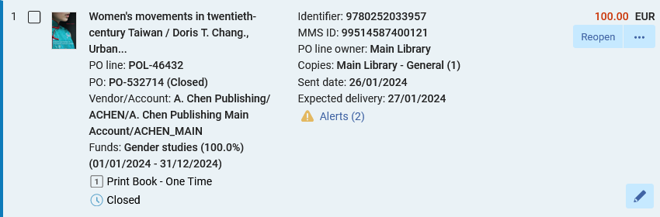
Invoicing (paying for) the POL
Now the POL is closed

Slide 52
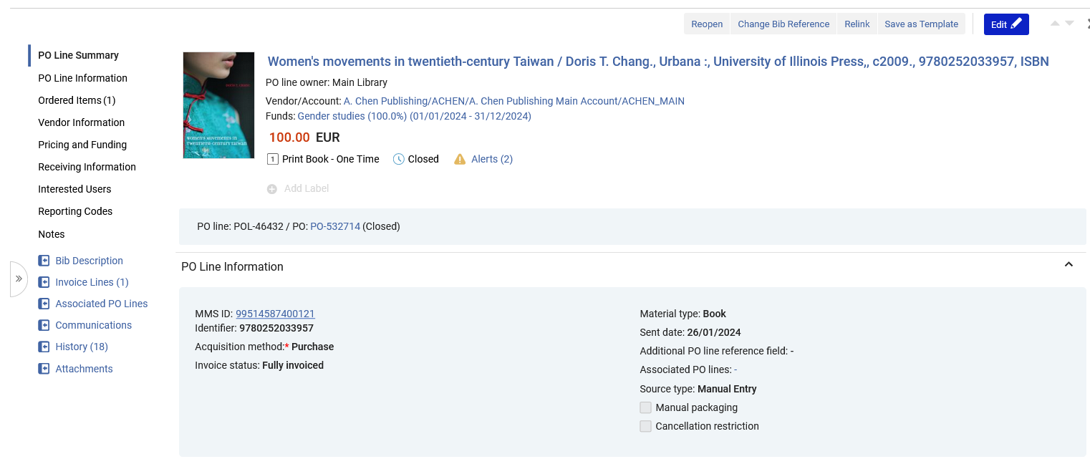
Invoicing (paying for) the POL
There is an invoice line associated with the POL
We will now click this link

Slide 53
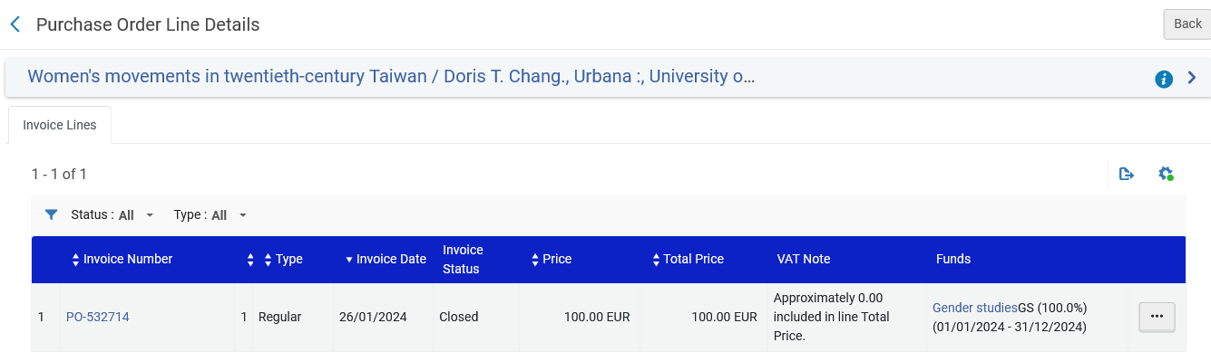
Invoicing (paying for) the POL
Here we see the invoice line associated with the POL (after clicking the link to the invoice line form the POL)

Slide 54
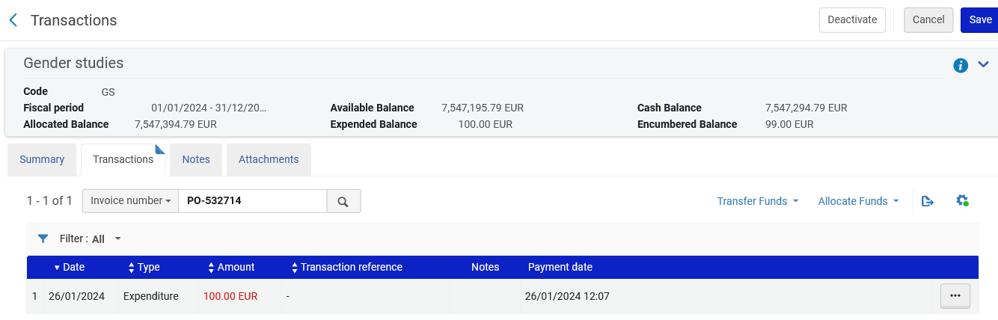
Invoicing (paying for) the POL
There is a transaction of type "Expenditure" on the fund

Slide 55
xxx@exlibrisgroup.com

